Slide 1
CSE 204 - INTRO TO Database Systems Database Development
Joseph LEDET
Department of Computer Engineering
Akdeniz University
josephledet@akdeniz.edu.tr

Slide 2
Outline
Main components of an information system.
Main stages of database system development lifecycle.
Main phases of database design: conceptual, logical, and physical design.
Benefits of CASE tools.
How to evaluate and select a DBMS.
Distinction between data administration and database administration.
Purpose and tasks associated with data administration and database administration.

Slide 3
Software Depression
Last few decades have seen proliferation of software applications, many requiring constant maintenance involving:
correcting faults,
implementing new user requirements,
modifying software to run on new or upgraded platforms.
Effort spent on maintenance began to absorb resources at an alarming rate.
As a result, many major software projects were
late,
over budget,
unreliable,
difficult to maintain,
performed poorly.
In late 1960s, led to ‘software crisis’, now refer to as the ‘software depression’.

Slide 4
Software Depression
Major reasons for failure of software projects includes:
lack of a complete requirements specification;
lack of appropriate development methodology;
poor decomposition of design into manageable components.
Structured approach to development was proposed called Information Systems Lifecycle (ISLC).

Slide 5
Information System
Resources that enable collection, management, control, and dissemination of information throughout an organization.
Database is fundamental component of IS, and its development/usage should be viewed from perspective of the wider requirements of the organization.

Slide 6
Database System Development Lifecycle
Database planning
System definition
Requirements collection and analysis
Database design
DBMS selection (optional)
Application design
Prototyping (optional)
Implementation
Data conversion and loading
Testing
Operational maintenance

Slide 7
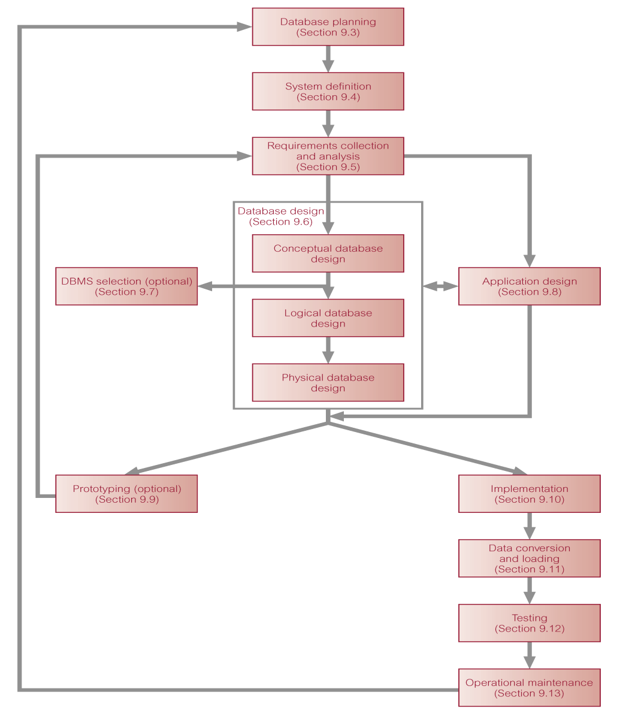
Stages of the Database System Development Lifecycle

Slide 8
Database Planning
Management activities that allow stages of database system development lifecycle to be realized as efficiently and effectively as possible.
Must be integrated with overall IS strategy of the organization.

Slide 9
Database Planning – Mission Statement
Mission statement for the database project defines major aims of database application.
Those driving database project normally define the mission statement.
Mission statement helps clarify purpose of the database project and provides clearer path towards the efficient and effective creation of required database system.

Slide 10
Database Planning – Mission Objectives
Once mission statement is defined, mission objectives are defined.
Each objective should identify a particular task that the database must support.
May be accompanied by some additional information that specifies the work to be done, the resources with which to do it, and the money to pay for it all.

Slide 11
Database Planning
Database planning should also include development of standards that govern:
how data will be collected,
how the format should be specified,
what necessary documentation will be needed,
how design and implementation should proceed.

Slide 12
System Definition
Describes scope and boundaries of database system and the major user views.
User view defines what is required of a database system from perspective of:
a particular job role (such as Manager or Supervisor) or
enterprise application area (such as marketing, personnel, or stock control).

Slide 13
System Definition
Database application may have one or more user views.
Identifying user views helps ensure that no major users of the database are forgotten when developing requirements for new system.
User views also help in development of complex database system allowing requirements to be broken down into manageable pieces.

Slide 14
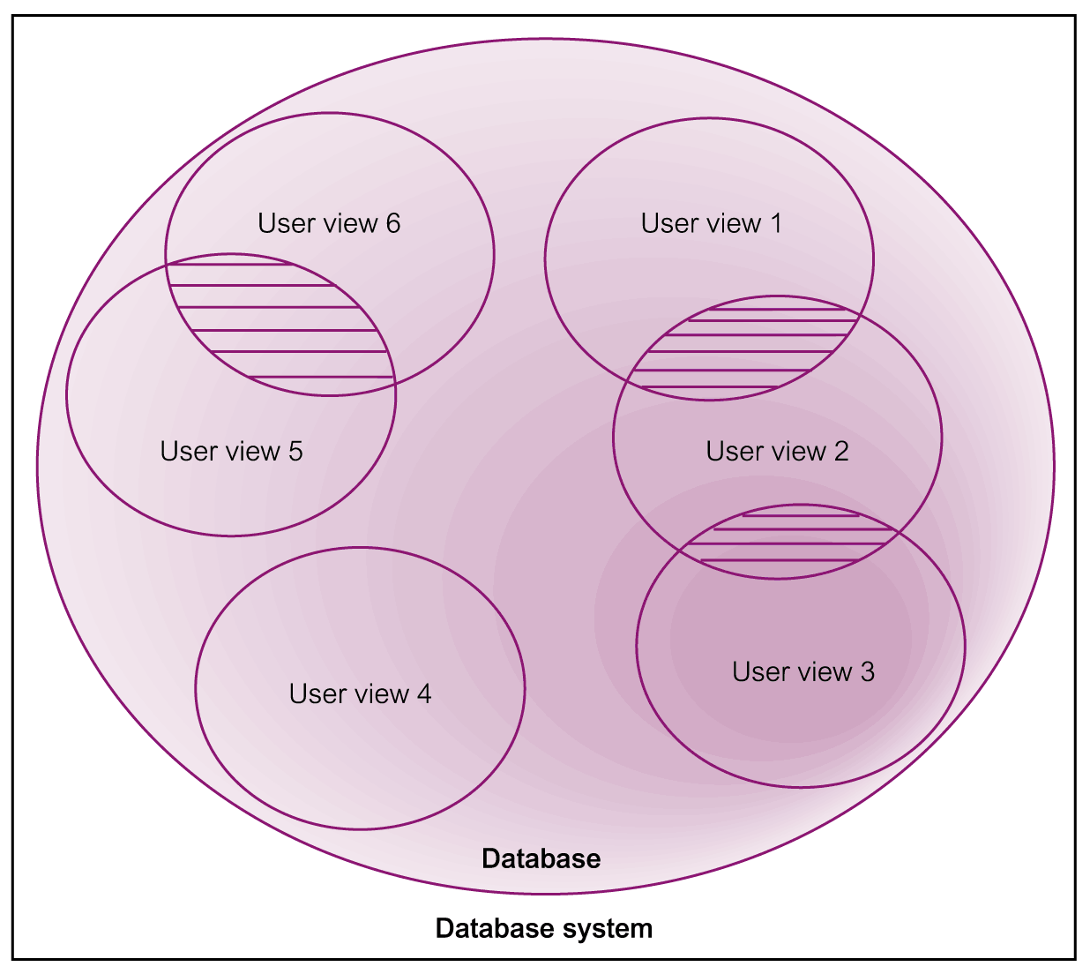
Representation of a Database System with Multiple User Views

Slide 15
Requirements Collection and Analysis
Process of collecting and analyzing information about the part of organization to be supported by the database system, and using this information to identify users’ requirements of new system.
Information is gathered for each major user view including:
a description of data used or generated;
details of how data is to be used/generated;
any additional requirements for new database system.
Information is analyzed to identify requirements to be included in new database system. Described in the requirements specification.

Slide 16
Requirements Collection and Analysis
Another important activity is deciding how to manage the requirements for a database system with multiple user views.
Three main approaches:
centralized approach;
view integration approach;
combination of both approaches.

Slide 17
Requirements Collection and Analysis
Centralized approach
Requirements for each user view are merged into a single set of requirements.
A data model is created representing all user views during the database design stage.

Slide 18
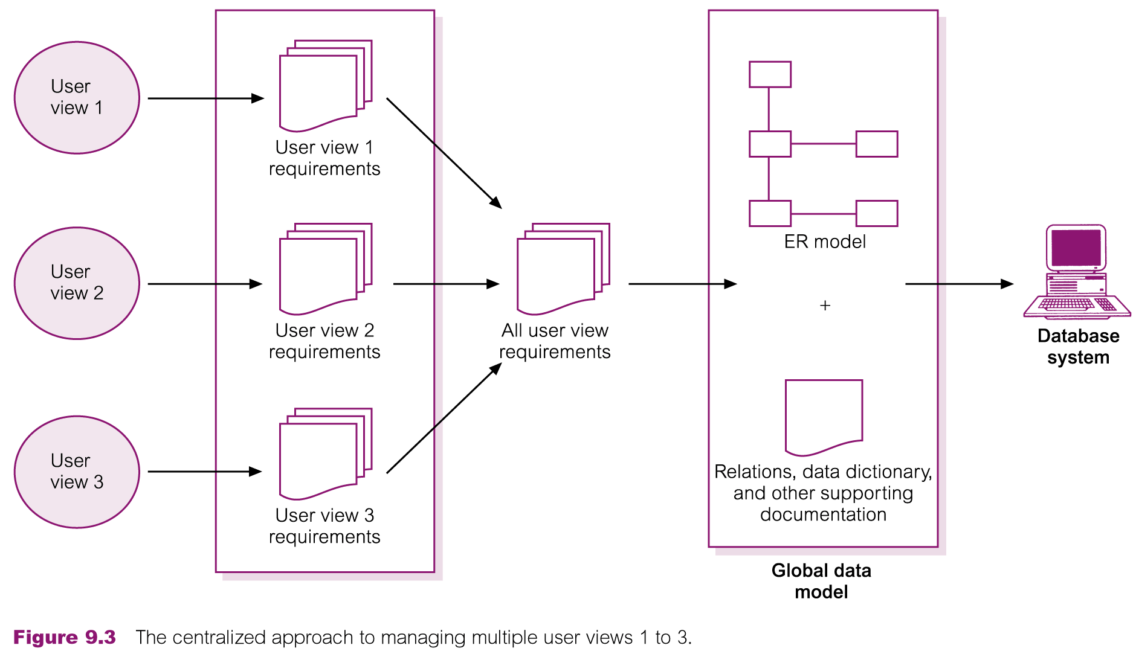
Centralized Approach to Managing Multiple User Views

Slide 19
Requirements Collection and Analysis
View integration approach
Requirements for each user view remain as separate lists.
Data models representing each user view are created and then merged later during the database design stage.
Data model representing single user view (or a subset of all user views) is called a local data model.
Each model includes diagrams and documentation describing requirements for one or more but not all user views of database.
Local data models are then merged at a later stage during database design to produce a global data model, which represents all user views for the database.

Slide 20
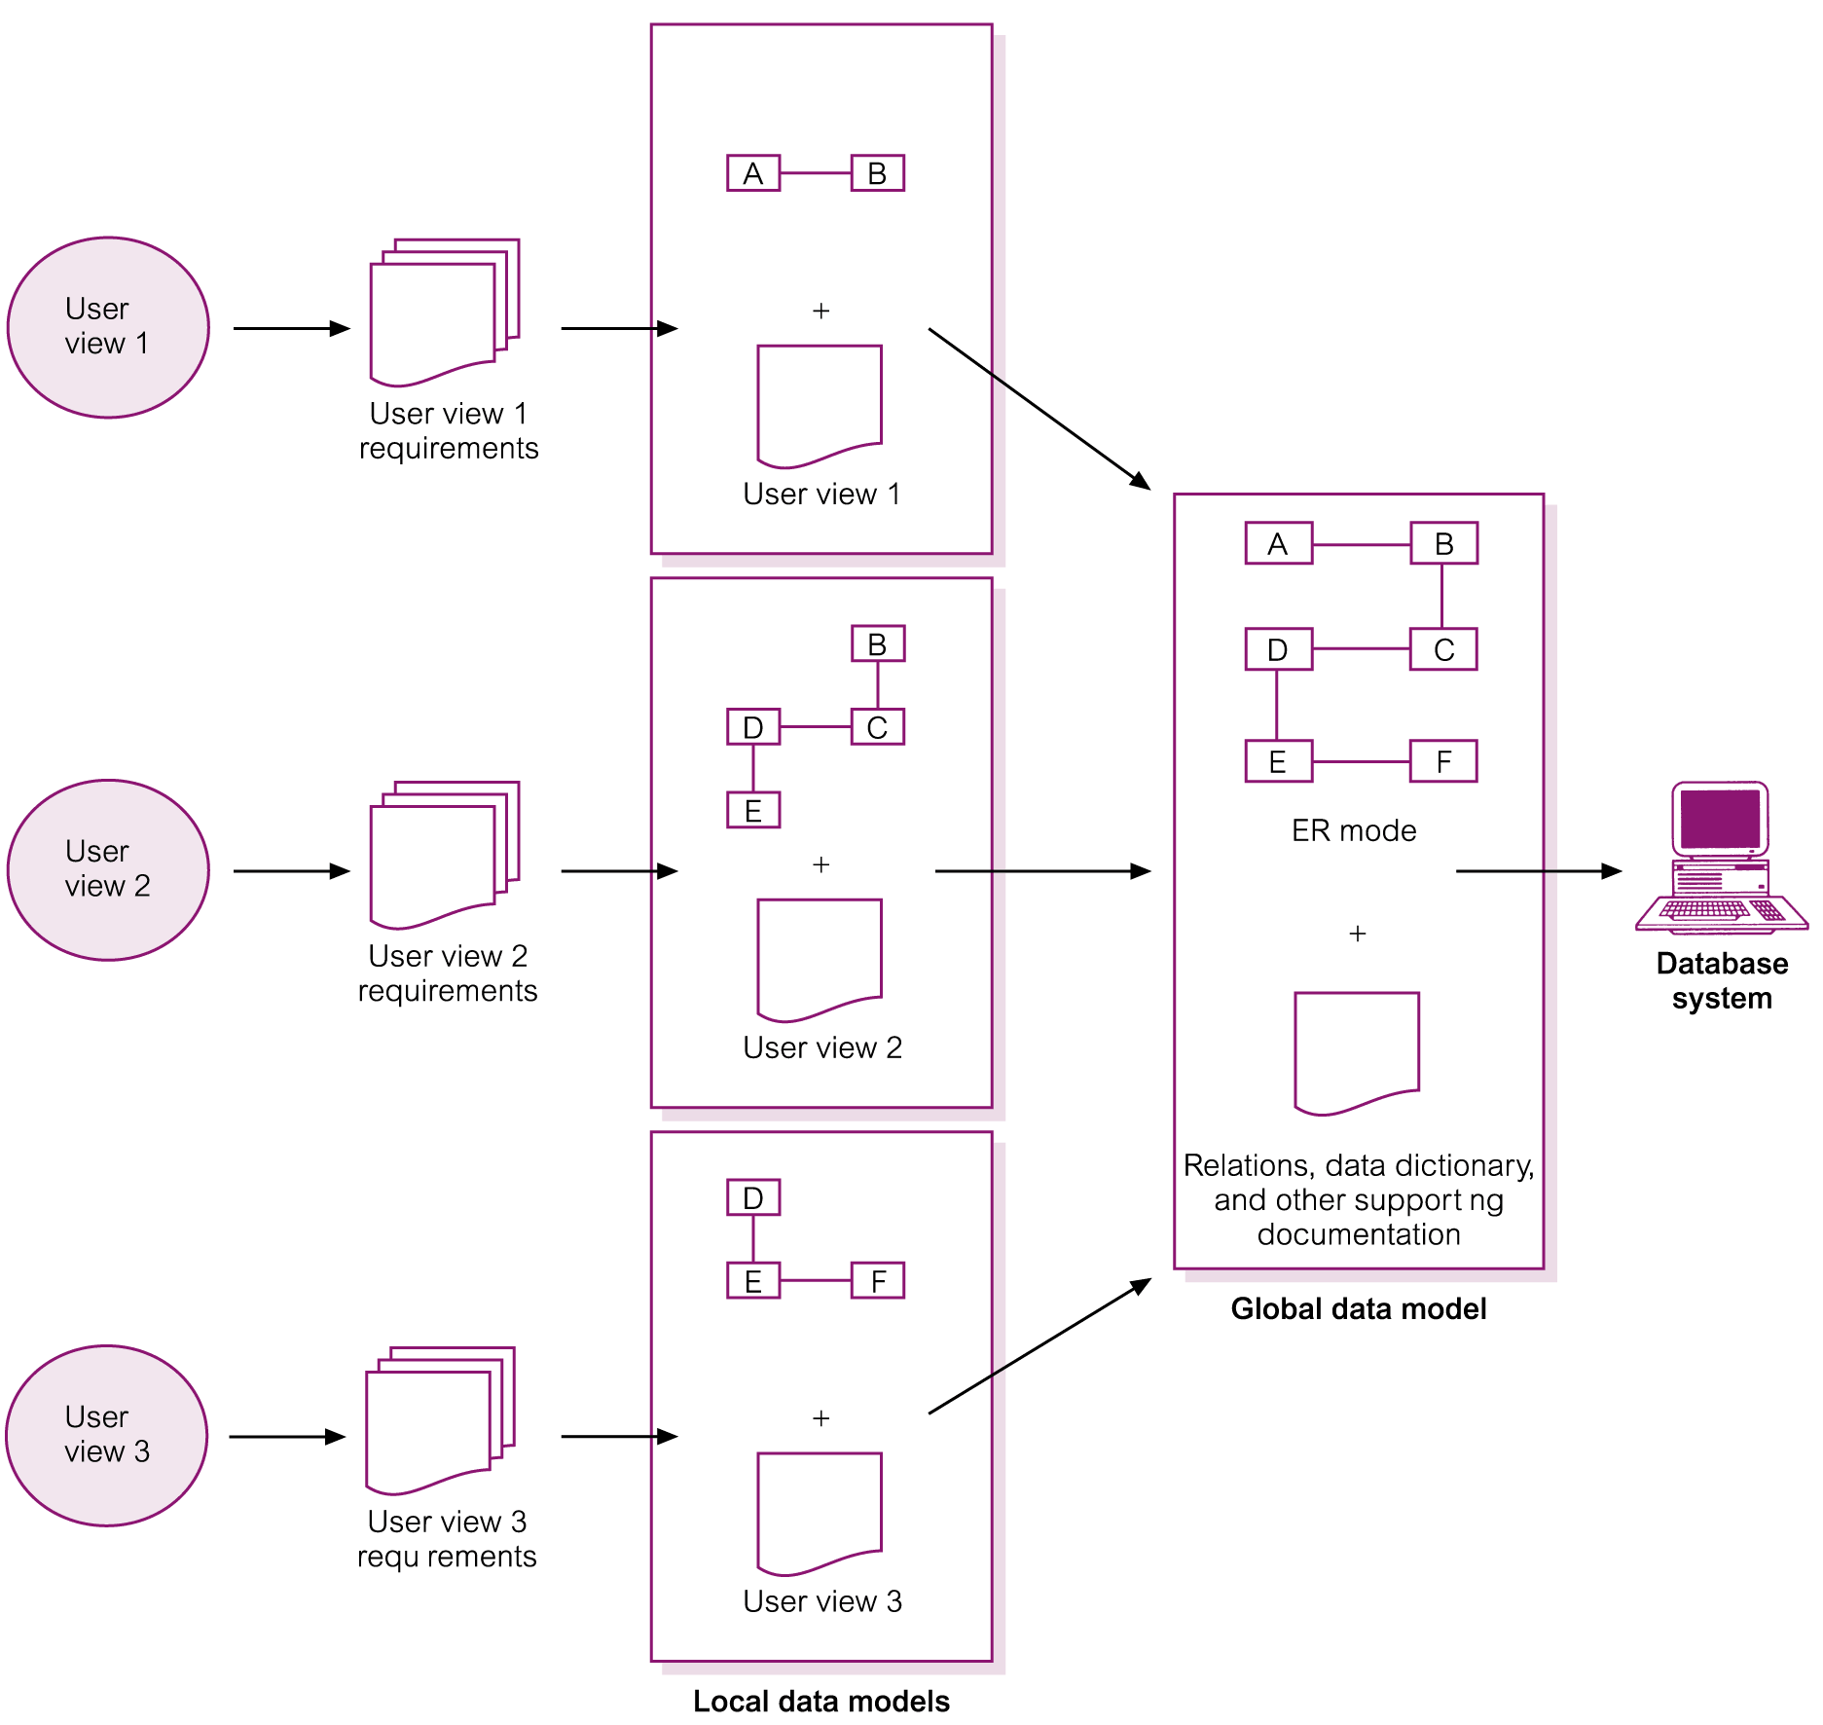
View Integration Approach to Managing Multiple User Views

Slide 21
Database Design
Process of creating a design for a database that will support the enterprise’s mission statement and mission objectives for the required database system.
Main approaches include:
Top-down
Bottom-up
Inside-out
Mixed

Slide 22
Database Design
Main purposes of data modeling include:
to assist in understanding the meaning (semantics) of the data;
to facilitate communication about the information requirements.
Building data model requires answering questions about entities, relationships, and attributes.
A data model ensures we understand:
each user’s perspective of the data;
nature of the data itself, independent of its physical representations;
use of data across user views.

Slide 23
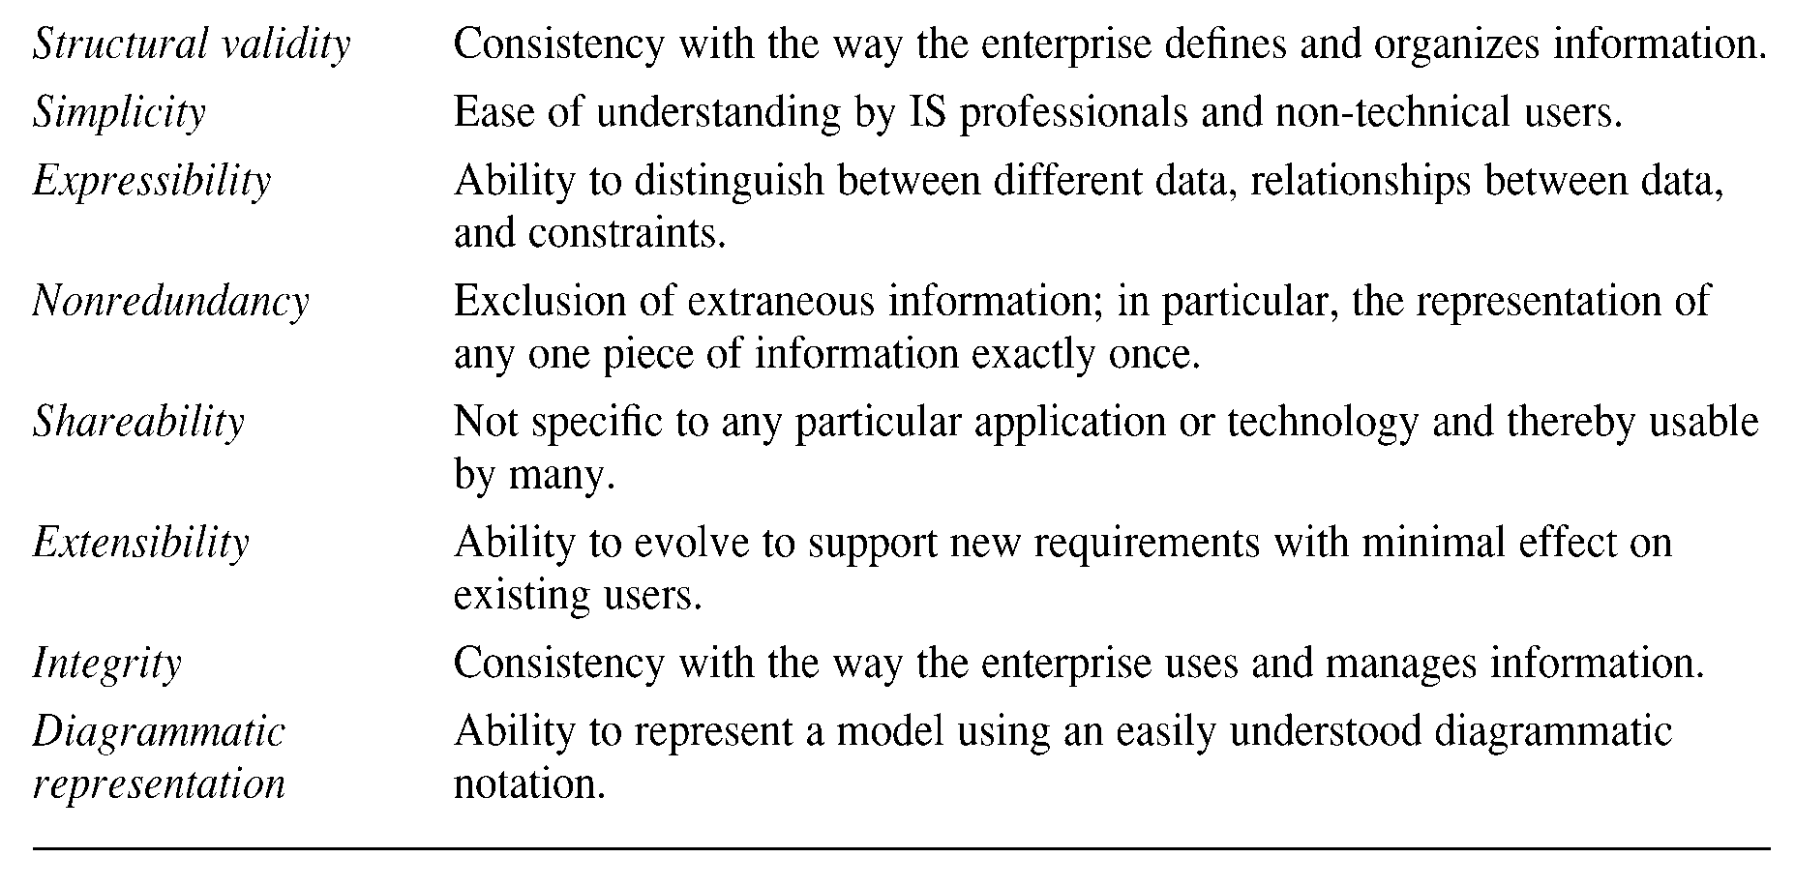
Criteria to Produce an Optimal Data Model

Slide 24
Database Design
Three phases of database design:
Conceptual database design
Logical database design
Physical database design.

Slide 25
Conceptual Database Design
Process of constructing a model of the data used in an enterprise, independent of all physical considerations.
Data model is built using the information in users’ requirements specification.
Conceptual data model is source of information for logical design phase.

Slide 26
Logical Database Design
Process of constructing a model of the data used in an enterprise based on a specific data model (e.g. relational), but independent of a particular DBMS and other physical considerations.
Conceptual data model is refined and mapped on to a logical data model.

Slide 27
Physical Database Design
Process of producing a description of the database implementation on secondary storage.
Describes base relations, file organizations, and indexes used to achieve efficient access to data. Also describes any associated integrity constraints and security measures.
Tailored to a specific DBMS system.

Slide 28
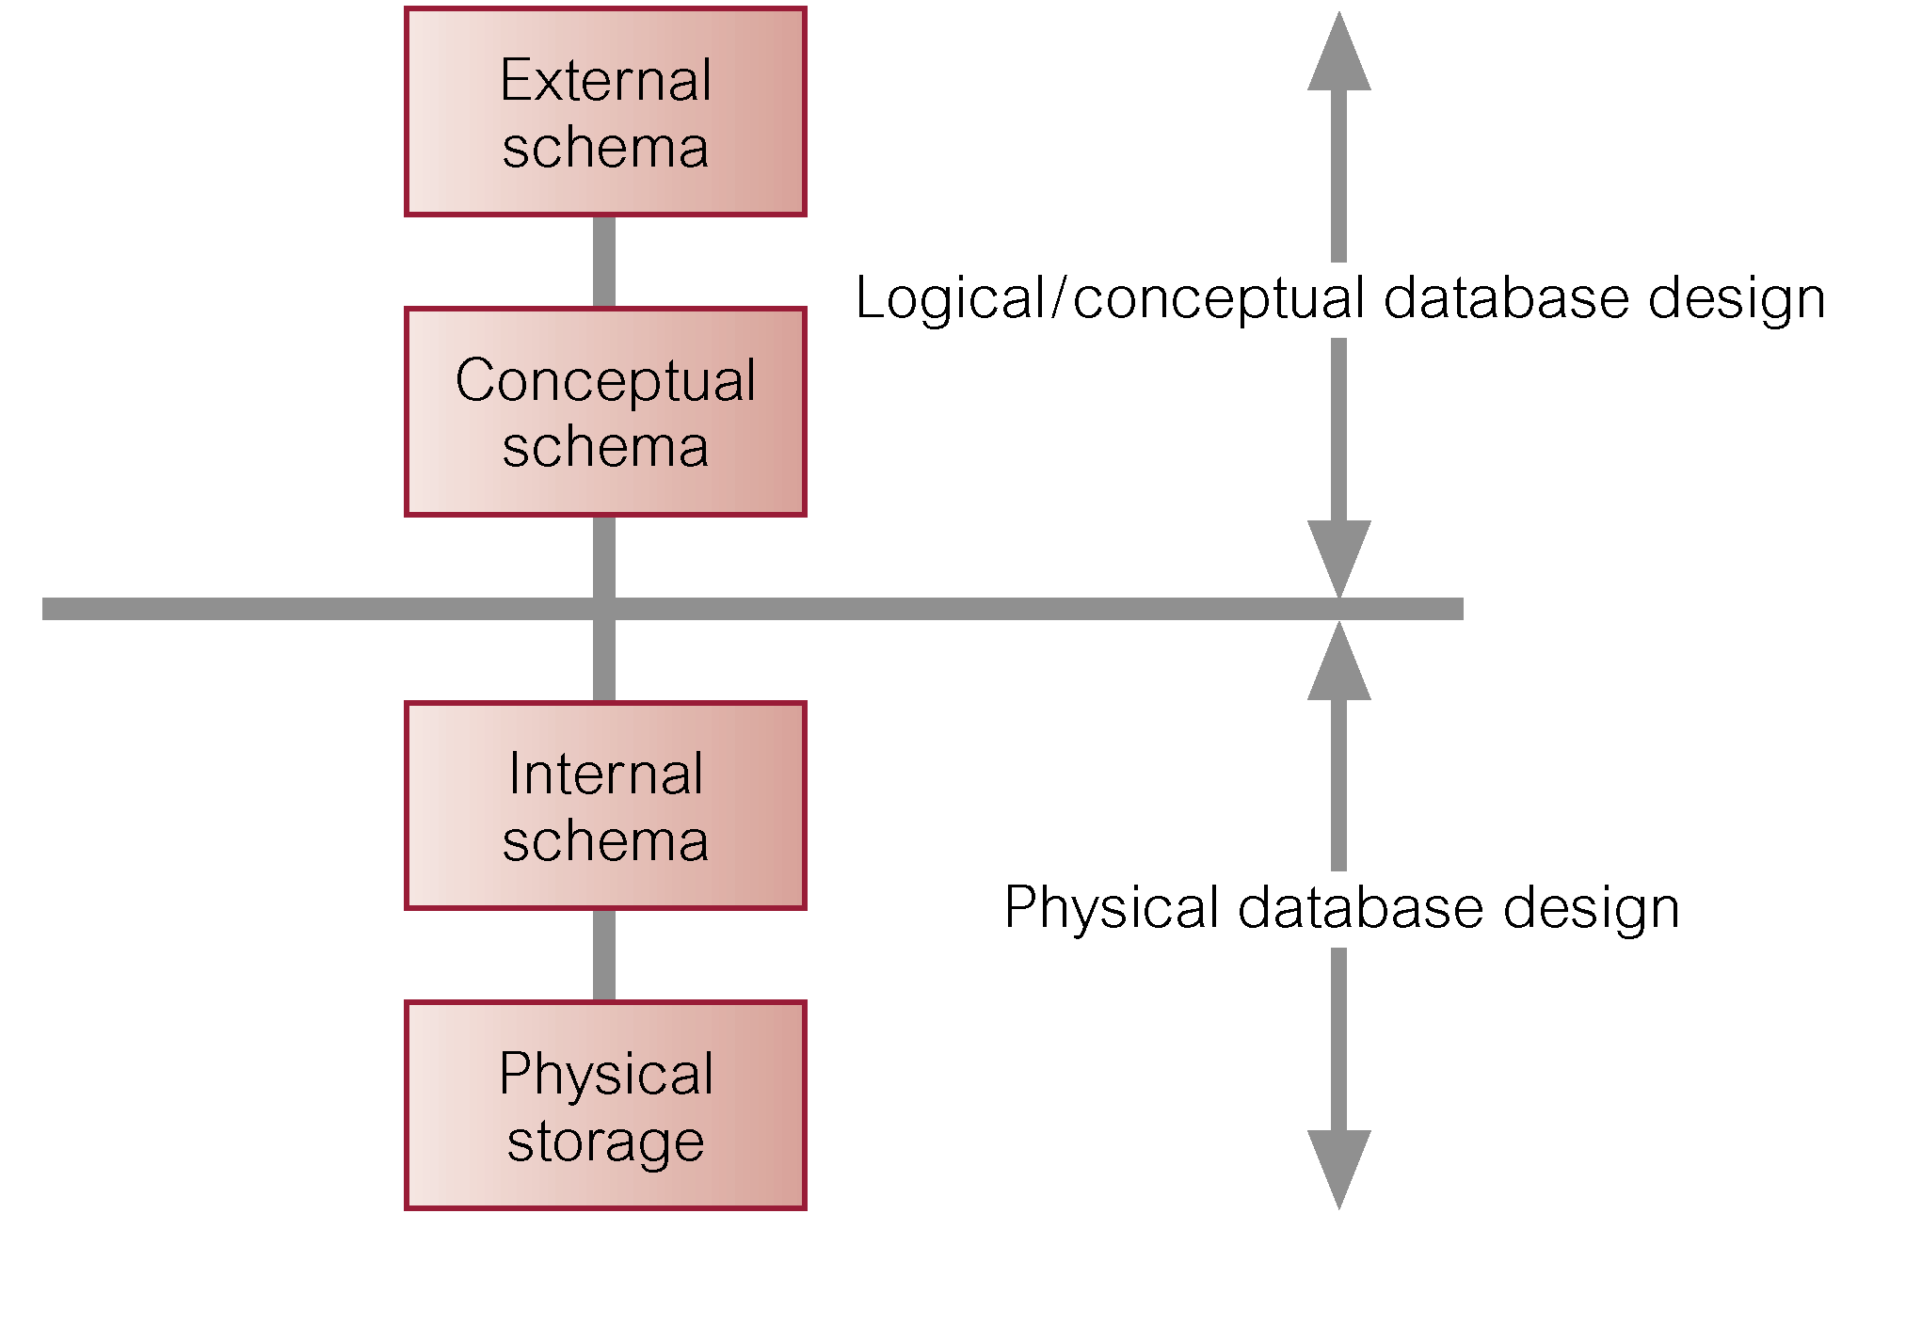
Three-Level ANSI-SPARC Architecture and Phases of Database Design

Slide 29
DBMS Selection
Selection of an appropriate DBMS to support the database system.
Undertaken at any time prior to logical design provided sufficient information is available regarding system requirements.
Main steps to selecting a DBMS:
define Terms of Reference of study;
shortlist two or three products;
evaluate products;
recommend selection and produce report.

Slide 30
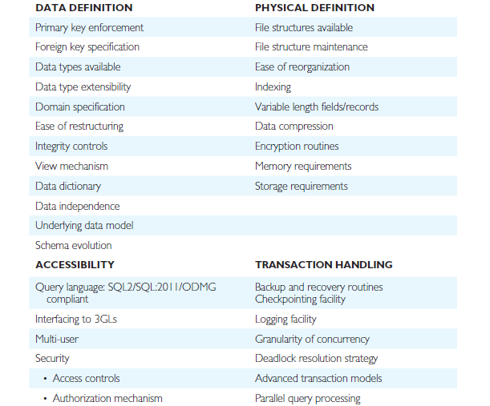
DBMS Evaluation Features

Slide 31
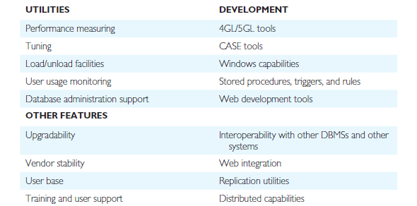
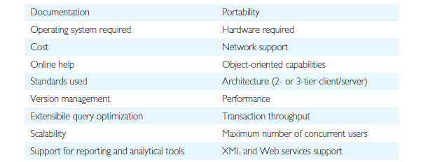
DBMS Evaluation Features

Slide 32
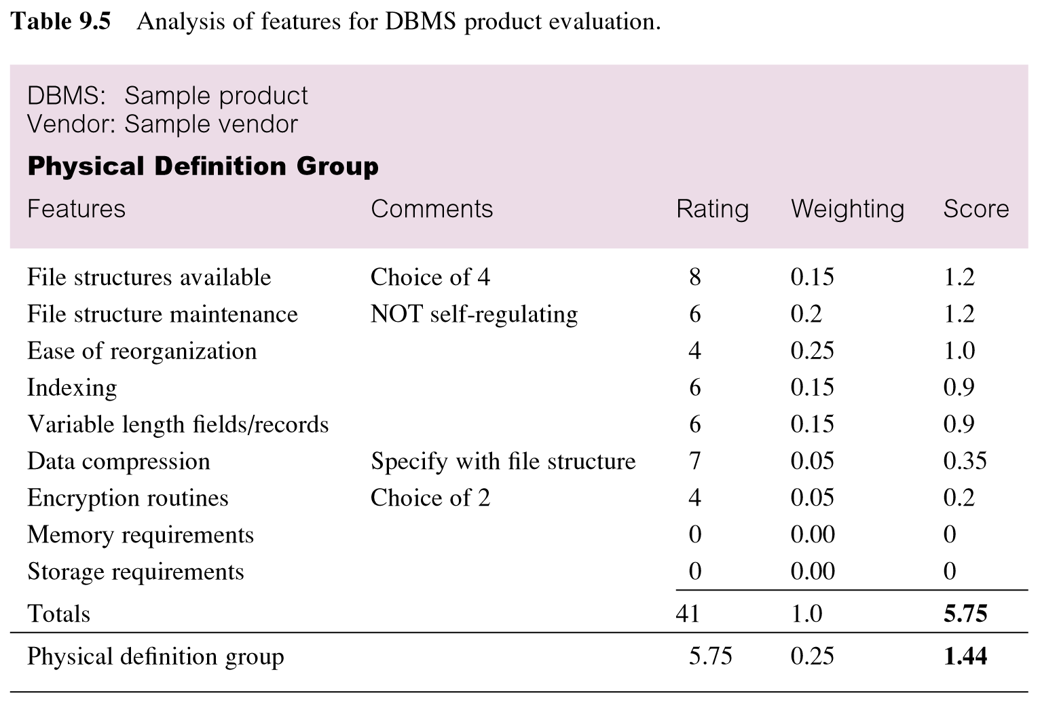
Example - Evaluation of DBMS Product

Slide 33
Application Design
Design of user interface and application programs that use and process the database.
Database design and application design are parallel activities.
Includes two important activities:
transaction design;
user interface design.

Slide 34
Application Design - Transactions
An action, or series of actions, carried out by a single user or application program, which accesses or changes content of the database.
Should define and document the high-level characteristics of the transactions required.

Slide 35
Application Design - Transactions
Important characteristics of transactions:
data to be used by the transaction;
functional characteristics of the transaction;
output of the transaction;
importance to the users;
expected rate of usage.
Three main types of transactions: retrieval, update, and mixed.

Slide 36
Prototyping
Building working model of a database system.
Purpose
to identify features of a system that work well, or are inadequate;
to suggest improvements or even new features;
to clarify the users’ requirements;
to evaluate feasibility of a particular system design.

Slide 37
Implementation
Physical realization of the database and application designs.
Use DDL to create database schemas and empty database files.
Use DDL to create any specified user views.
Use 3GL or 4GL to create the application programs. This will include the database transactions implemented using the DML, possibly embedded in a host programming language.

Slide 38
Data Conversion and Loading
Transferring any existing data into new database and converting any existing applications to run on new database.
Only required when new database system is replacing an old system.
DBMS normally has utility that loads existing files into new database.
May be possible to convert and use application programs from old system for use by new system.

Slide 39
Testing
Process of running the database system with intent of finding errors.
Use carefully planned test strategies and realistic data.
Testing cannot show absence of faults; it can show only that software faults are present.
Demonstrates that database and application programs appear to be working according to requirements.

Slide 40
Testing
Should also test usability of system.
Evaluation conducted against a usability specification.
Examples of criteria include:
Learnability;
Performance;
Robustness;
Recoverability;
Adaptability.

Slide 41
Operational Maintenance
Process of monitoring and maintaining database system following installation.
Monitoring performance of system.
if performance falls, may require tuning or reorganization of the database.
Maintaining and upgrading database application (when required).
Incorporating new requirements into database application.

Slide 42
CASE Tools
Support provided by CASE tools include:
data dictionary to store information about database system’s data;
design tools to support data analysis;
tools to permit development of corporate data model, and conceptual and logical data models;
tools to enable prototyping of applications.
Provide following benefits:
Standards;
Integration;
Support for standard methods;
Consistency;
Automation .

Slide 43
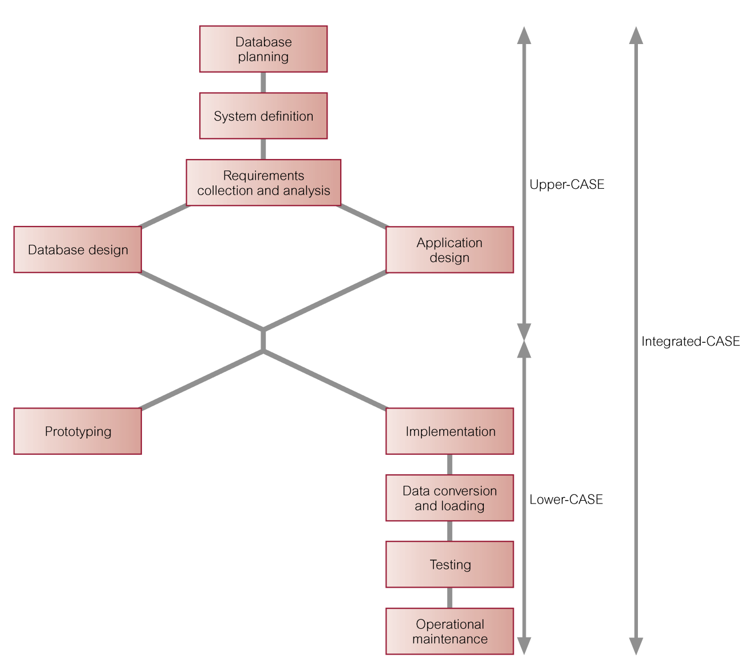
CASE Tools and Database System Development Lifecycle

Slide 44
Data Administration and Database Administration
The Data Administrator (DA) and Database Administrator (DBA) are responsible for managing and controlling the corporate data and corporate database, respectively.
DA is more concerned with early stages of database system development lifecycle and DBA is more concerned with later stages.

Slide 45
Data Administration
Management of data resource including:
database planning,
development and maintenance of standards, policies and procedures, and conceptual and logical database design.

Slide 46
Database Administration
Management of physical realization of a database system including:
physical database design and implementation,
setting security and integrity controls,
monitoring system performance, and reorganizing the database.

